Slide 1


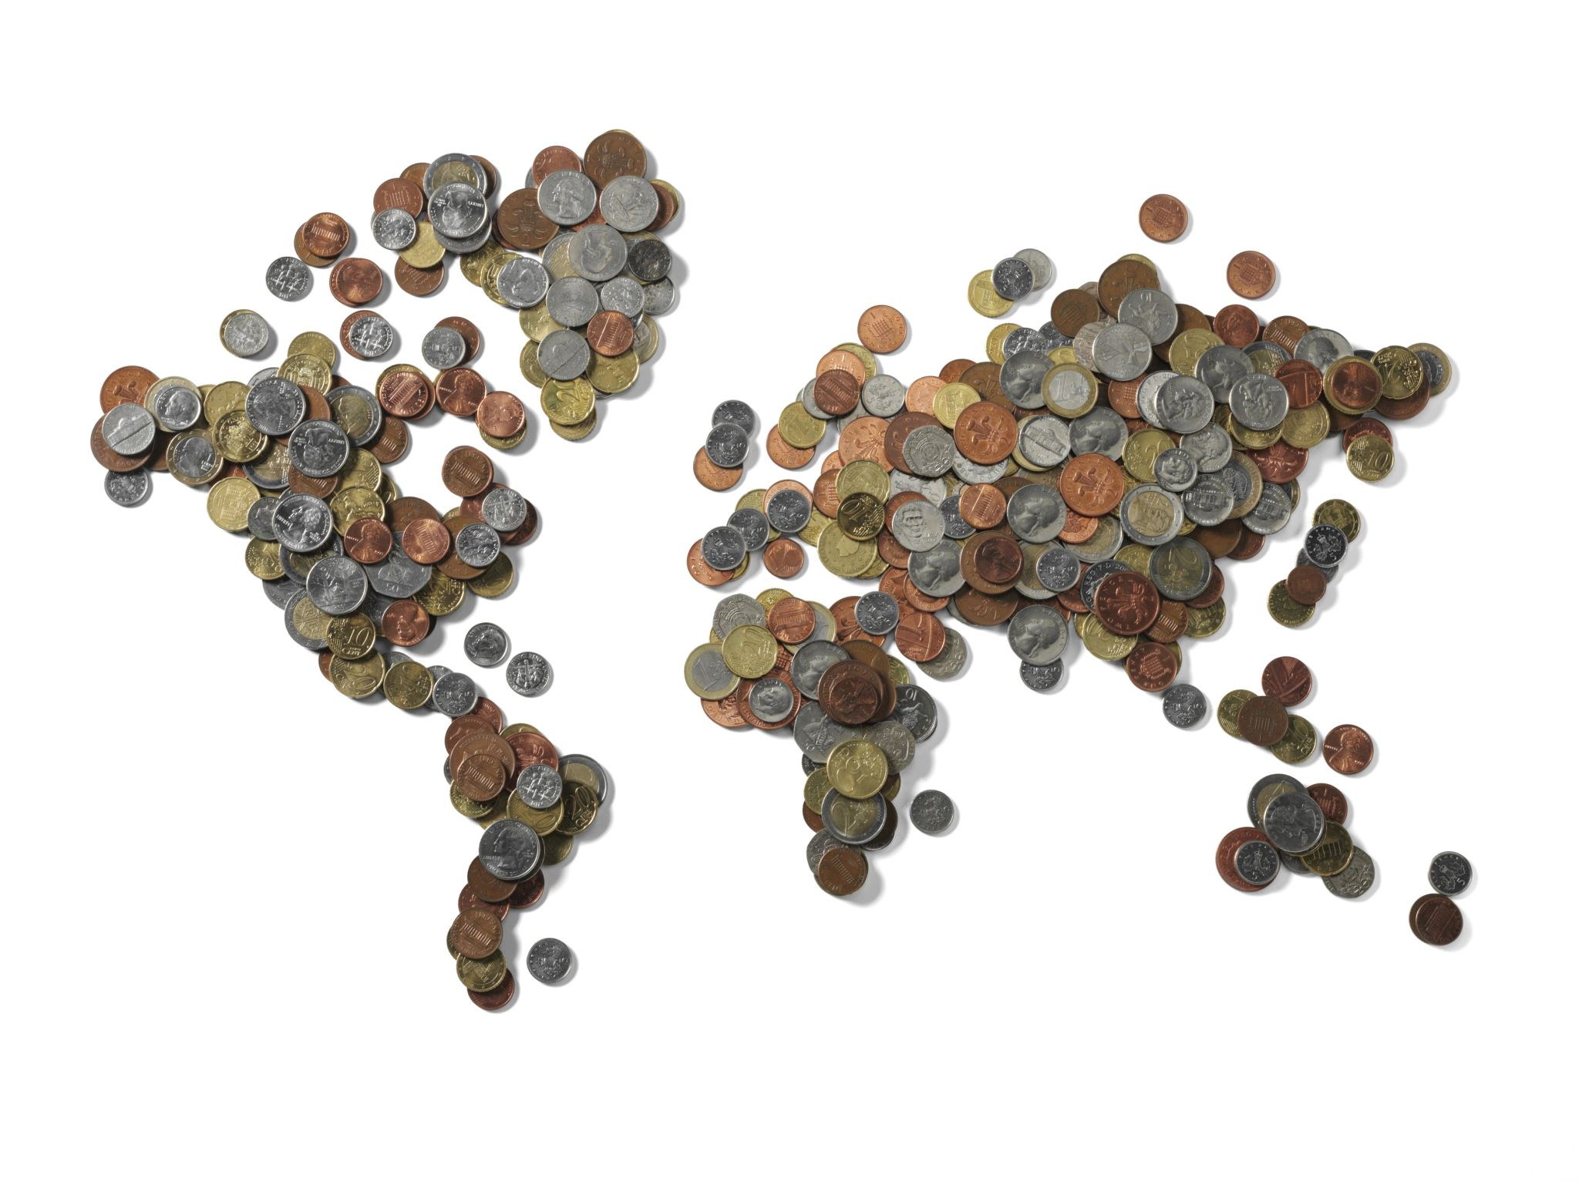
Crowdfunding
By
Team Nexus

Slide 2
Agenda
Team Member Roles and Responsibilities
Problem Statement
Project Description
User Personas
MVP
Tools and Technology
Algorithms and Logic
Project Schedule
Team Working Agreement
Sprint 0 Retrospective

Slide 3

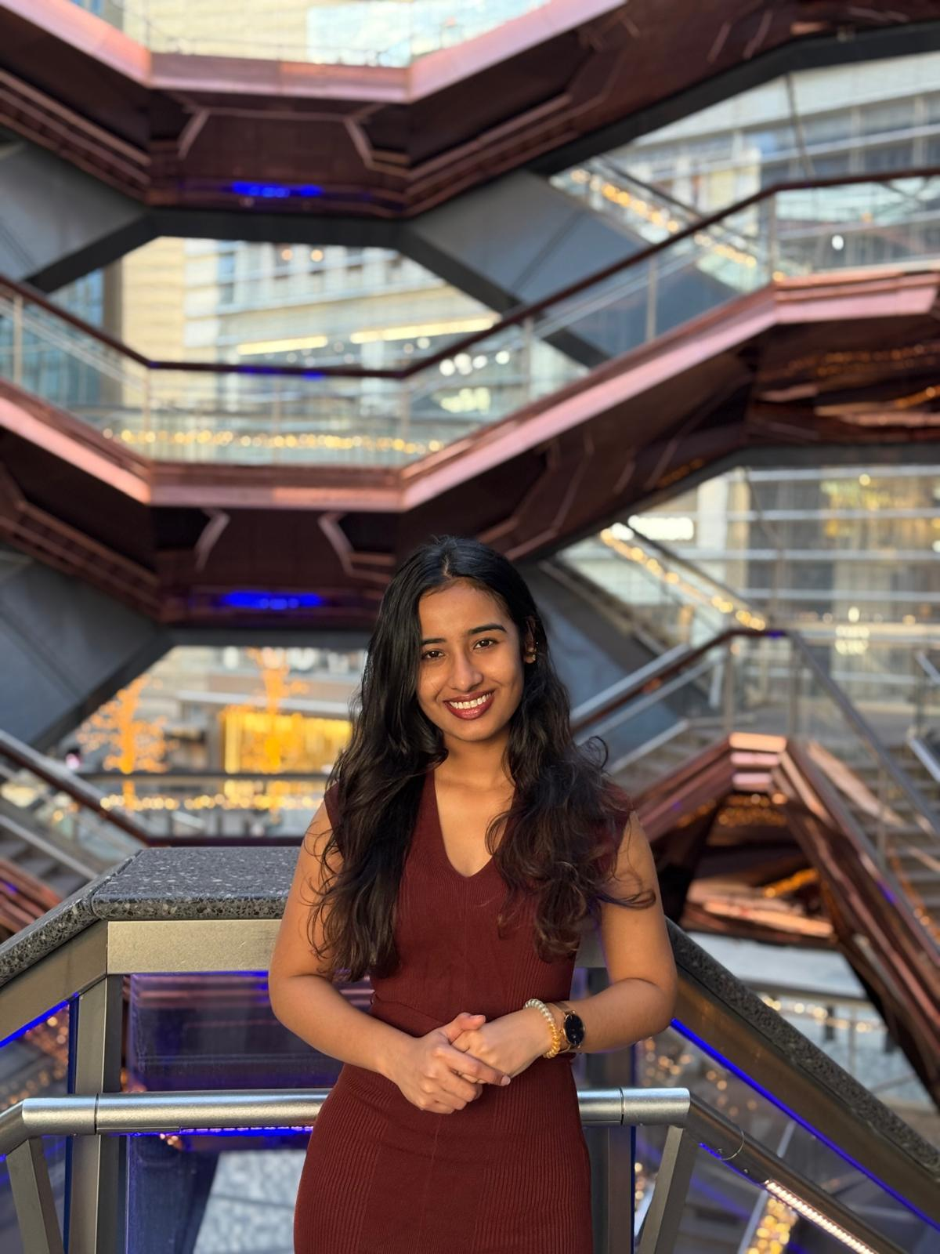
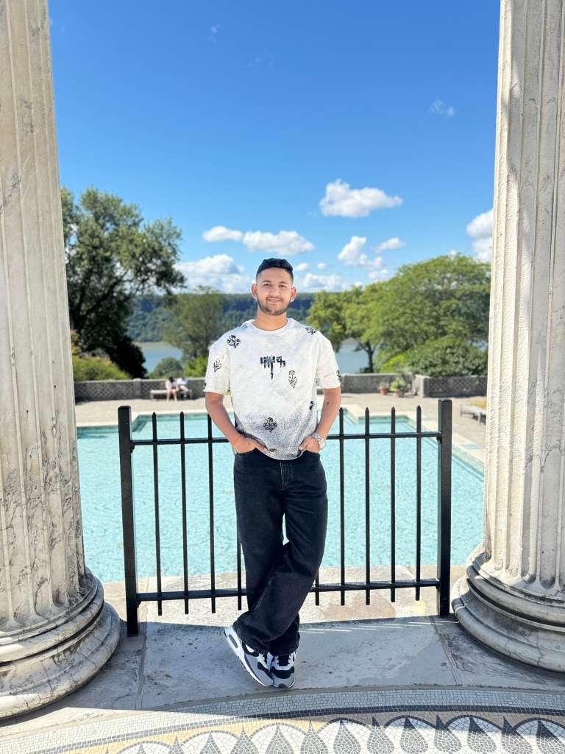
Getting to know the Team…
Ashwanth Maram Full Stack Developer
Ashwitha Maram
Developer/Tester
Raj Mandaliya
Block Chain Developer

Slide 4
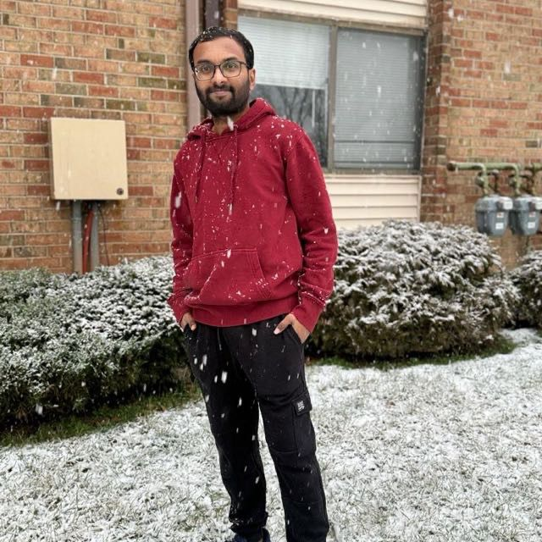
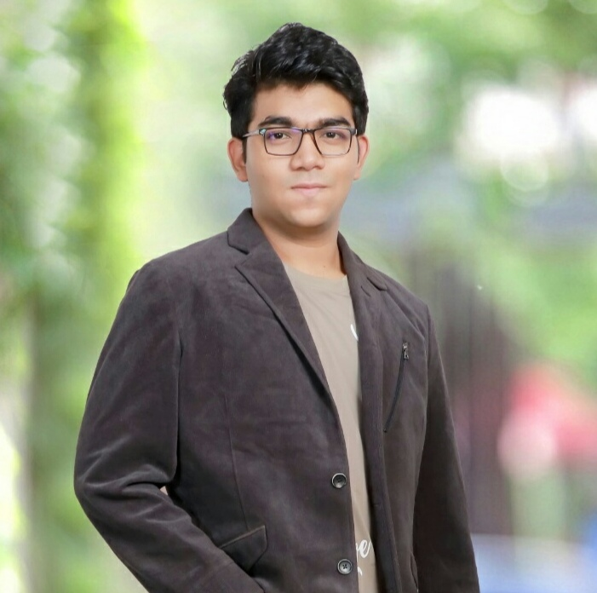

Getting to know the Team…
Vinukonda Yashwanth Reddy Backend and Database Engineer
Nyi Nyi Lwin Full Stack Developer
Naveen Pesalabanda
SCRUM Master

Slide 5
The Problem we are Solving….
High fees on traditional crowdfunding platforms(Kickstarter, GoFundMe, etc.)
Lack of transparency in fund usage
Centralized control by platform owners
Trust issues between contributors and project creators
Crowd Funding tackles these challenges by using blockchain smart contracts for secure, transparent, and automated fund management.
Crowd Funding has the potential to make fundraising fair, low-cost, and community-driven, while giving contributors confidence and control.

Slide 6
Project Description
What is Crowd Funding?
Crowd Funding aims to be a decentralized blockchain-based platform for fundraising which provides a transparent and secure way for creators to raise money for their projects Designed to remove intermediaries and reduce high platform fees Allows contributors to track how funds are used and participate in spending decisions
It includes:
Campaign creation and Funding
Contributor voting on fund usage
Automatic refunds if goals not met
Community driven governance

Slide 7
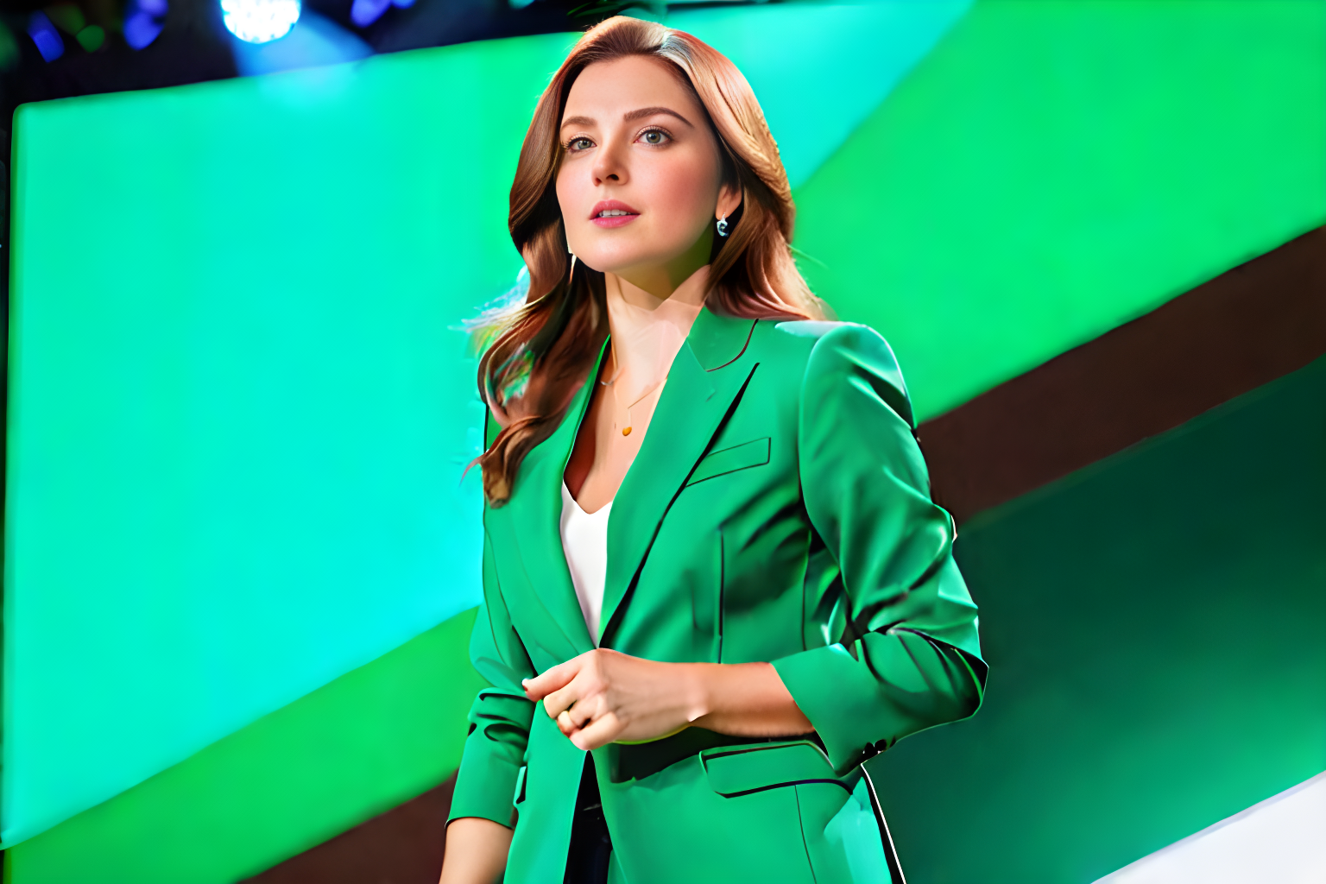
The Startup Founder Persona
Name: Alice Johnson Age: 28 Gender: Female Occupation: Startup Founder
Alice is an ambitious entrepreneur developing a sustainable fashion brand. She wants to raise money to bring her eco-friendly products to market but struggles with high fees and limited visibility on traditional crowdfunding platforms.
Challenges:
Struggles to gain trust from contributors due to lack of transparency.
Centralized platforms charge high fees, cutting into her funding.
Limited control over how her campaign is presented.
Goals:
Raise funds fairly and transparently.
Build credibility with backers.
Ensure contributors see exactly how their money is being used.

Slide 8

The Investor Persona
Name: Bob Smith Age: 35 Gender: Male Occupation: Investor
Bob is a passionate investor who likes to fund innovative projects. He wants to support creators but often worries about whether his money is being used properly and feels disconnected after contributing.
Challenges:
Unsure if funds are spent transparently
No refunds if a project fails
Has no control once money is invested
Goals:
Invest with full transparency and security
Receive refunds if funding goals aren’t met
Have a say in how project funds are used through voting

Slide 9

The Community Member Persona
Name: Cathy Lee Age: 22 Gender: Female Occupation: College Student / Community Member
Cathy is an active member of online communities and DAOs. She enjoys contributing to causes but wants her voice to count, not just her money.
Challenges:
No say in how project funds are allocated
Hesitant to contribute without accountability
Finds most platforms profit-driven and restrictive
Goals:
Participate in voting and decision-making
Support transparent, community-driven projects
Learn about blockchain while backing meaningful causes

Slide 10
MVP
Campaign Creation: Allow users to launch funding campaigns with metadata (title, goal, deadline).
Contribution Logic: Accept ETH contributions and track them per user.
Refund Mechanism: Automatically refund contributors if the goal isn’t met.
Governance Voting: Let contributors vote on fund allocation or milestones.

Slide 11

TOOLS &Technologies
Blockchain: Ethereum + Solidity
Development: Remix IDE, Hardhat
Network: MetaMask, Sepolia Test Network, Sepolia ETH Faucets
Deployment & Testing: Hardhat
Collaboration Tools: GitHub, VS Code

Slide 12
Algorithms & Logic
Smart Contract–Based Voting Mechanism Implements a weighted voting system based on user stake or role. Ensures tamper-proof, transparent decision-making using smart contracts.
Refund Logic Automatically refunds users if the funding goal is not achieved. Executed via smart contract conditions to ensure user trust.
Fraud Detection Rules (Optional) Detects suspicious behavior like duplicate voting or fake contributions. Helps maintain fairness and integrity in decentralized processes.

Slide 13
Project Schedule
Sprint 0 – Sep 25
Finalize project topic
Finalize tech stack
Create & update GitHub Wiki
Conduct retrospective
Sprint 1 – Oct 23
Plan contract components
Define user stories & assign tasks
Update Wiki pages
Conduct retrospective
Sprint 2 – Nov 22
Develop and integrate contract features
Deploy test version
Update Tech Paper
Conduct retrospective
Sprint 3 – Dec 11
Integrate & finalize all work
Update Wiki & finalize tech paper
Conduct retrospective

Slide 14
Team Working Agreement
Communication Expectations
Use Zoom, GitHub for collaboration.
Respect everyone opinions; decisions are made collectively.
Notifying the team in advance if you cannot complete or attend.
In case of any conflicts, present research-backed solutions and resolve by majority vote.
Keeping everyone updated when pushing code or making changes.
No last-minute dumping of work on others.
Meeting Schedules
Meetings will be held twice weekly on Zoom or Google meet
Meeting time is set based on availability.
Agenda will be shared in advance for preparation.
Sprint Planning at the start, Retrospective at the end of each sprint.
Absence must be informed ahead of time; member must read meeting summary.
All members are expected to participate and contribute fairly.

Slide 15
Team Working Agreement
Checklist for Task Completion
Code should run without errors.
Work must meet all acceptance criteria.
Each task is reviewed and tested by everyone
Documentation should be updated with the task.
Final review by all team members before submission.
Team Dynamics & Principles
Each member must clearly understand and own their tasks.
Workload distributed fairly; large tasks broken into smaller ones.
Every task has a deadline and review on completion.
Encourage problem-solving before escalating blockers.
Trackers must be updated regularly.
Work progress should be committed and shared on GitHub.

Slide 16
Sprint 0 Retrospective
What went well:
Good collaboration & role distribution
What can be improved:
More structured time management
Action Items:
Use Trello/Jira for task tracking
Set clear deadlines for each deliverable

Slide 17

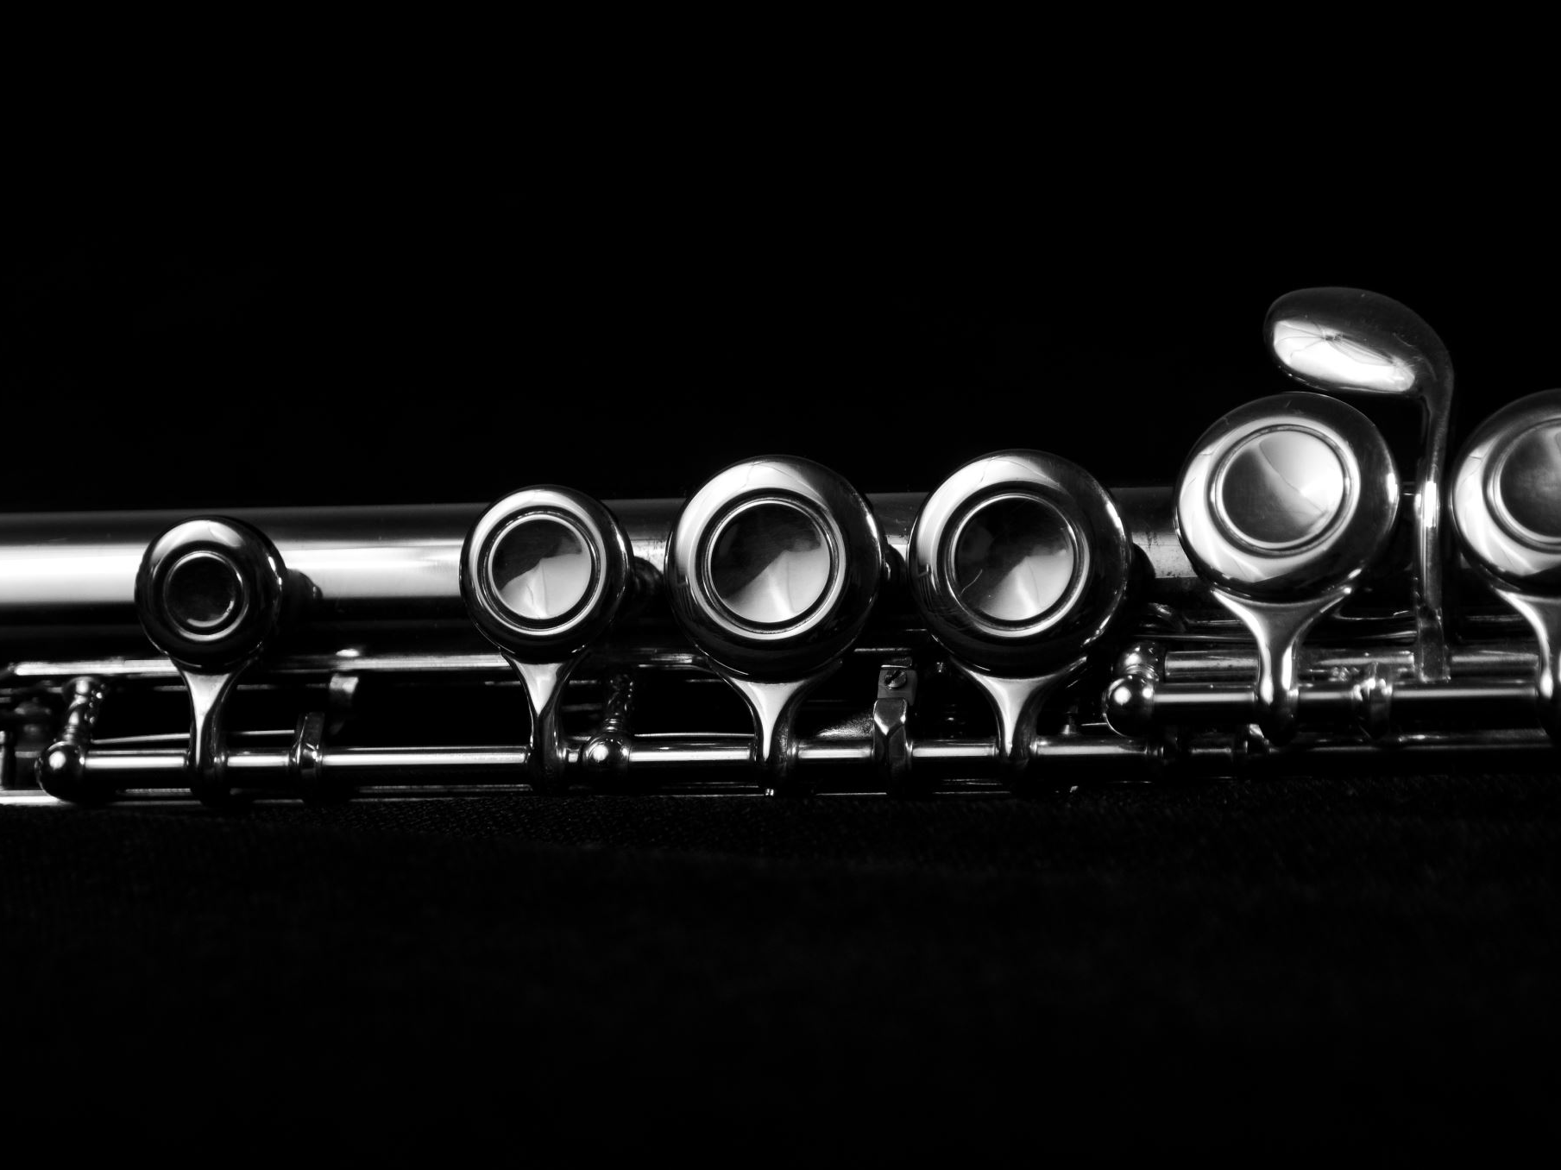
Wiki Page LINK
Home · htmw/F2025-Team2 Wiki

Slide 18
Thank You!

